Slide 1


Grainger plc
Voids Process Discovery
January 2023
1

Slide 2

Contents
Background slide 3
Executive summary slide 4
High-level briefing slide 5
Next Steps slide 12
Detailed findings
Process findings slide 17
SWOT analysis slide 38
Appendices
Discovery methodology slide 40
Process metrics slide 42
Interview detail slide 45
PEX assessment & guidance slide 60
embracent | Grainger
2

Slide 3
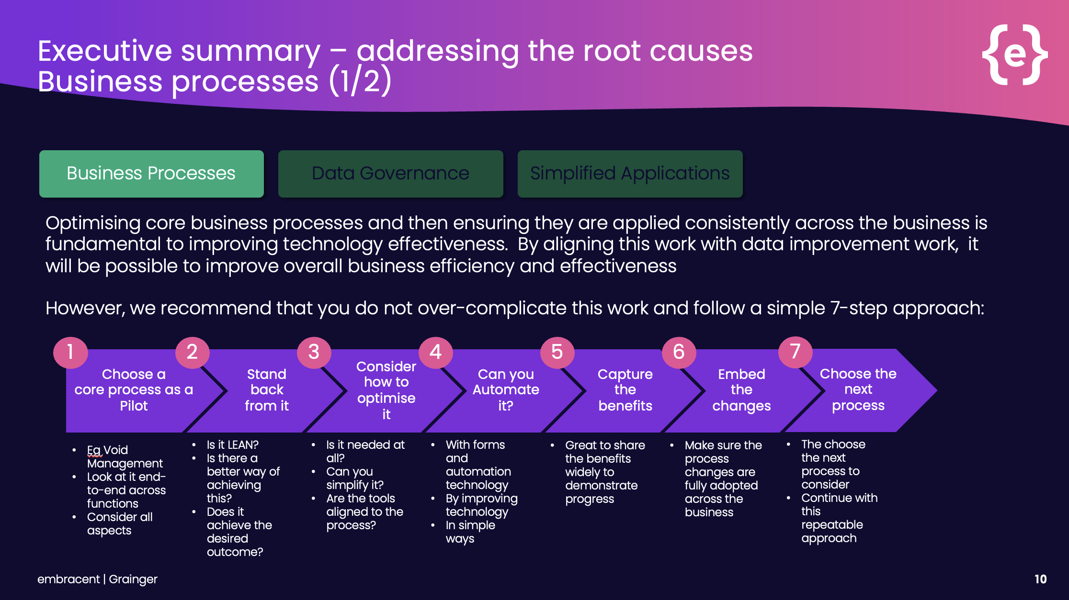

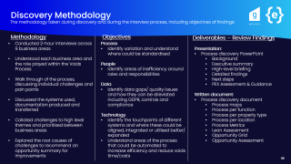
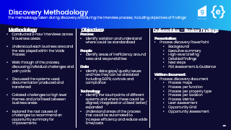
Background
Our previous review identified opportunities to simplify and automate your current complex operating procedures
It recommended a simple approach – starting with Void Management (this review) – based on the following phases:
1
optimised & standardised
Optimise complex business processes and then apply them consistently across the business to deliver significant benefits
Click to Navigate!
2
automated
Automate the enhanced processes to drive further
efficiency and repeatability
3
link to data for insight
Align this work with the data improvement work to further improve business efficiency and effectiveness and
deliver insight
This paper presents the findings of the ‘void to let’ process review, as part of phase 1 above
3

Slide 4
Executive Summary
Current process
complex inconsistent
unclear
Many different processes are followed across functions, property types and locations, with limited performance metrics or tracking
Significant manual intervention required with multiple documents and work-arounds
This makes the task of reducing voids very challenging as we have no way of measuring current performance or tracking improvements
Future process
standardised
In order to optimise Voids, we recommend a collaborative redesign of the process which focuses on the below 3 design principles:
1. standardisation of how the process is completed, regardless of the property type or business area
2. structuring inputs and creating rules-based logic that can be automated
3. ensuring the process information is accessible, accurate and visible end to end, across the business
There is potential to reduce the manual steps taken in the process by ~50% and manual documents created/handled by ~80% at ~2-3 minutes per document
50%
less manual
steps
taken
simplified
(end-to-end)
80%
less
documents handled
transparent
(for insight)
next steps
design “one” process
measure performance
apply best fit technologies
right size, RACI & train
4

Slide 5
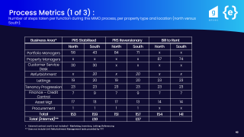
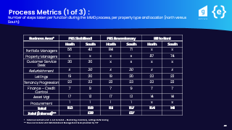
High-level briefing
The current process is highly inefficient and inconsistent – requiring huge amounts of manual intervention and offering little opportunity to monitor like-for-life performance
Amount of intervention needed
Business Area* | PRS Stabilised |  | PRS Reversionary |  | Bill to Rent
 | North | South | North | South | North | South
Portfolio Managers
Property Managers
Customer Service Desk
Refurbishment (URM)
Lettings
Tenancy Progression
Finance – Credit Control
Asset Mgt
Procurement
Very high (70+ steps)
High (51+ steps)
Medium (21-50 steps)
Low (5-20 steps)
Minimal <5 steps)
Click to Navigate!
*External parties were not interviewed including Marketing, Inventory, referencing and refurbishment contractors however, Unit Refurbishment Managers were included in discovery, due to their more secondment like partnership with Grainger plc
It became clear that there is no single process followed across functions, property types or locations leading to many off-system workarounds
5

Slide 6
High-level briefing
Value Stream per MIMO (~)
Root Cause
Opportunity
6 internal functions involved from future vacant to move in
35 emails are sent
25 handover points
35 - 45 documents created/ handled (BTR-PRS)
5-10 different documents from north to south (BTR-PRS)
North complete 10% more steps than the South (non-contracted)
Perceptions of employee to property differences between locations
5+ Tracking sheets maintained
Up to 8 x double keying of information between systems
Process
Complex processes with different ways of working
Too many handover points
Data
Required information is often not available within systems
No visibility of the end-to-end process
No single version of the truth
No true picture of the voids cost or performance
People
Different resourcing between north and south
Lack of accountability
Technology
System limitations
Lack of integration/ automation
In order to optimise Voids, we recommend a collaborative redesign of the process which focuses on the below 3 design principles:
1. standardisation of how the process is completed, regardless of the property type or business area
2. structuring inputs and creating rules-based logic that can be automated
Includes tactical RPA opportunities to improve data challenges
3. ensuring the process is accessible, accurate and visible end to end, across the business
6
Notes:
Variation - PRS has a more complex asset approval and refurbishment process leading to variation in steps and the documentation produced
Manual work - Process and technology changes over time have led to data being stored locally and not visible within systems, resulting in teams overprocessing
Tracking MIMO across systems - Multiple business areas work across different systems preventing visibility of task statuses, creating inefficiency
System limitations - There is a lack of accountability due to unclear handover points and field technology limitations resulting in missing or delayed data within systems and frustration between teams
People & training - Variance in sizing's - Different ratios of properties to managers and dedicated internal resource, north to south, have led to frustrations among people and delays in processing voids/ information gaps
Data gaps/ performance - No single version of the truth, resulting in unkempt KPIs and no true picture of the voids cost or performance…

Slide 7
High-level briefing
In order to optimise the Voids process, we recommend standardisation of how the process is completed, regardless of the property type or business area:
optimised & standardised
automated
transparent
Standard pricing play book – Extend property price playbook to the South, updated and shared at selected intervals throughout year
Why?
Standardise between north and south, shared with teams via Salesforce - Replace the manual steps taken during asset approval
Reduce the need for approvals and email exchanges
1
Standard Specification:
Standardise the specification for BTR & PRS with tick boxes/ standardised pricing
Localised partnerships with one contractor per area - organise schedule for rates and agree with contractor, system can then auto select based on location and create works order
Price per property (PPP), Schedule of rates (SOR) then falls out of PPP
Why?
Standardise between PRS and BTR, North and South
Eliminate the need to:
Gather and process multiple quotes
Create workarounds in Proactis for those who do not meet requirements, maintaining data transfer with contractors within MRI, as is done with refresh works
Reduce the need for property managers to create technical specifications leading to issues during the refurbishment and creating delays
Reduce the steps taken by ~60% during the refurbishment/ approval process
Increase relationships with contractors to bring day 0 work starts to 100% (currently at 40%)
2
7

Slide 8
High-level briefing
In order to optimise the Voids process, we recommend structuring inputs and logic, automating
tasks wherever possible:
optimised & standardised
automated
transparent
Digitise and structure the notice to quit received by tenants, mirroring the inputs needed in MRI to be able to automatically kick start the process
Why?
Removes the manual steps of double keying / requesting information from the NTQ. Auto creates the MIMO task and associated tasks for move out (resell process excluded)
1
Approval layers and workflows accessed within the system, with notifications for actions required
Why?
Centralises communications to the system and forces proper procedure re approvals.
Removes retrospective approvals
2
Use RPA to upload historic unit intelligence and automate rules-based tasks
Why?
Make unit information accessible and remove the need for off system comms/documentation such as key location and previous refurbishment dates
3
Create logic-based rules to reduce the need for clarification and guidance on refurbishment/ sell/ refresh
Why?
Rules based on length of time since previous works and properties proactively marked to sell to:
Reduce time taken to market property
Reduce manual steps/ handover points
4
8
Notes:
Digitise and structure the notice to quit received by tenants, mirroring the inputs needed in MRI to be able to automatically kick start the process
Approval layers and workflows accessed within the system, with notifications for actions required
Use automation to ensure all historic unit intelligence is uploaded to the system and available to populate downstream documentation/decision making, such as key location and previous refurbishment dates
Create logic-based rules to reduce the need for clarification and guidance on refurbishment/sell/ refresh, based on length of time since previous works and properties proactively marked to sell– reducing XX
Automating rules-based tasks within systems to reduce manual steps
Utilise customer facing technology to automate deposit returns/ compliance documentation required on move in – reducing XX
Automate any data input/ collection to third party systems and portals such as tenancy deposit, utilities, council tax – reducing XX

Slide 9
High-level briefing
In order to optimise the Voids process, we recommend structuring inputs and logic, automating
tasks wherever possible:
optimised & standardised
automated
transparent
Utilise customer facing technology to automate deposit returns/ compliance documentation required on move in
Why?
Centralises communications/updates & reduces emails
Improves customer experience
Reduce documentation creation/ handling
5
Automate any data input/ collection to third party systems and portals such as tenancy deposit, utilities, council tax, inventory hive
Why?
Reduce number of manual steps
Reduce handover points between systems and the time taken to navigate/ transfer information
Reduces delays/ downstream information gaps & frustration
6
9
Notes:
Digitise and structure the notice to quit received by tenants, mirroring the inputs needed in MRI to be able to automatically kick start the process
Approval layers and workflows accessed within the system, with notifications for actions required
Use automation to ensure all historic unit intelligence is uploaded to the system and available to populate downstream documentation/decision making, such as key location and previous refurbishment dates
Create logic-based rules to reduce the need for clarification and guidance on refurbishment/sell/ refresh, based on length of time since previous works and properties proactively marked to sell– reducing XX
Automating rules-based tasks within systems to reduce manual steps
Utilise customer facing technology to automate deposit returns/ compliance documentation required on move in – reducing XX
Automate any data input/ collection to third party systems and portals such as tenancy deposit, utilities, council tax – reducing XX

Slide 10
High-level briefing
In order to optimise the Voids process, we recommend ensuring the process is accessible,
accurate and visible end to end, across the business:
optimised & standardised
automated
transparent
Accurate process information - Ensure all required information and data points are held and accessible within the systems
Why?
Remove the need for off system comms/documentation such as key location and previous refurbishment dates
1
Simplify data input – ensure the same information is only CRUD (created, read, updated, deleted) in one place throughout the process
Why?
Remove double keying between systems/ documents and people
Reduce transactional data collection that is not useful
2
Create clear and measurable KPIs and implement accessible and dynamic dashboard style process tracking
Why?
Ability to measure the performance of each void
Improve accountability and people performance
All areas can track the end-to-end status, per MIMO, eliminating the need for off system trackers
3
Ensure field employees have access to the information they need, to be able to update in near real time
Why?
Reduce delays on information
Improve downstream process and turn around times
Reduce data gaps & increase accountability
4
10
Notes:
Accurate, accessible and visible process information
Once the process is standardised, simplify the technology to one system or ensure systems are integrated to reduce double keying
Ensure all required information and data points are held and accessible within the systems
Evaluate the need for Qube within this process for transactional updates, mainly used by external refurbishment to log refurbishment details and Asset teams to and track and report on voids
Enhance technology to ensure field employees have access to the information they need to be able to update in near real time, reducing delays and frustrations downstream
Ensure information is available and accurate for reporting, creating KPIs based on void costs and process performance leading the ability to right size team to property ratios and ringfences resource in other teams e.g. customer services
Create clear and measurable KPIs and implement accessible and extend dynamic dashboard style process tracking across the end-to-end process, not just within Salesforce
This would reduce the need for XX emails and XX tracking reports and improve

Slide 11






High-level benefits
standardised
“one” process across property types, locations
and functions:
100% voids starting on day 0 (60% increase)
Eliminate 5-7 days waiting/chasing on contractors to return quotes
Eliminate bespoke specifications for each refurbishment
All works ordered and tracked via same system
Reduction in lost rents for 60% of refurbishment turnarounds:
Documents created, handled and shared
Reduction in turnaround time between tenancies
All works to start on day 0
simplified
(end-to-end)
Simplified and accurate processing:
Structured, data inputs that feed directly to systems
Automated processes to reduce manual interventions and human input between systems and third parties
Digitised and centralised comms with customers
50% less manual intervention
~80% less handling/creating documents
50% reduction in manual intervention:
Manual intervention
Increased employee satisfaction
Improved customer experience
transparent
(for insight)
Ability to gain insight on factors affecting:
Void cost
Effective lead management / viewings
Turnaround time between tenancies​
Rental growth at the point of renewing a tenancy ​
Retention rates
The ability to track each void & factors end to end:
100%
Trackers/Double keying removed
Emails & off system comms
Ability to measure & track performance
11

Slide 12


1. design “one” process
ensure performance can be measured
apply best fit technologies
right size, RACI & train
Next Steps
1. Collaboratively design one end to end “to-be” process that follows the same steps, documentation and logic regardless of property type, location or role completing the task:
Hold workshops with all business areas to make future process decisions and understand required exception handling
Stick to the 3 design principles, ensuring exceptions to the “one” process are only for legal requirements, customer experience and business need and stick to it
Use the detailed analysis conducted during discovery to understand current variance and steer standardisation
Simplify manual tasks through creating structured, rules-based logic that can be automated within systems
Click to Navigate!
12

Slide 13
design “one” process
2. ensure performance can be measured
apply best fit technologies
right size, RACI & train
Next Steps
2. Ensure the status of each void is visible to all and performance can be measured:
Ensure there is one version of the truth
Clarity on how the performance (KPIs) of the process is tracked and ensure the data required is input and accessible
13
Notes:
Overlay the standardised and simplified process with best fit technology:
Deep dive into technologies, with a decision made on moving the entire process to one system or integrating systems to reduce double keying and ensure visibility of end-to-end void status between teams
Automation of any manual tasks that sit outside of Grainger systems e.g. third party portals
Digitise communications and information transfer with tenants through utilising applications (spike/ salesforce)
Eliminate manual tasks through RPA, such as document transfers and emails with customers
Ensure data can be input by employees out in the field

Slide 14
design “one” process
ensure performance can be measured
3. apply best fit technologies
right size, RACI & train
Next Steps
Overlay the standardised and simplified process with best fit technology – requires a technology deep dive to understand how technology is best utilised, accessible to those who need it and can easily be tracked from end to end
Deep dive into technologies, with a decision made on moving the entire process to one system or integrating systems to reduce double keying and ensure visibility of end-to-end void status between teams
Automation of any manual tasks that sit outside of Grainger systems e.g. third party portals
Digitise communications and information transfer with tenants through utilising applications (spike/ salesforce)
Eliminate manual tasks through RPA, such as double keying, document transfers and emails with customers
Ensure data can be input by employees out in the field
14
Notes:
Overlay the standardised and simplified process with best fit technology:
Deep dive into technologies, with a decision made on moving the entire process to one system or integrating systems to reduce double keying and ensure visibility of end-to-end void status between teams
Automation of any manual tasks that sit outside of Grainger systems e.g. third party portals
Digitise communications and information transfer with tenants through utilising applications (spike/ salesforce)
Eliminate manual tasks through RPA, such as document transfers and emails with customers
Ensure data can be input by employees out in the field

Slide 15
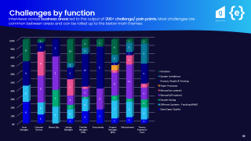
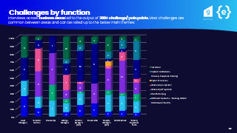
design “one” process
ensure performance can be measured
apply best fit technologies
4. right size, RACI & train
Next Steps
Right size teams, clarify roles and responsibilities with clear RACIs, handover points and trainings in place to ensure “one” process is adopted, and accountability taken
Alleviate and work with functions to alleviate perceptions of the process,
collected during the interview process
Share “good news” of how the process is improving and ensure feedback loops
are in place until fully adopted
Click to Navigate!
15
Notes:
Overlay the standardised and simplified process with best fit technology:
Deep dive into technologies, with a decision made on moving the entire process to one system or integrating systems to reduce double keying and ensure visibility of end-to-end void status between teams
Automation of any manual tasks that sit outside of Grainger systems e.g. third party portals
Digitise communications and information transfer with tenants through utilising applications (spike/ salesforce)
Eliminate manual tasks through RPA, such as document transfers and emails with customers
Ensure data can be input by employees out in the field

Slide 16
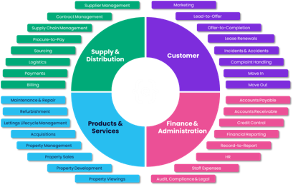
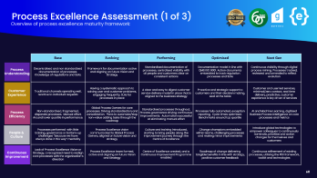

Wider Next Steps
There is discussion needed over next steps regarding your wider process landscape:
1. Repeating the optimisation methodology across your process framework
Which order?
How do we prioritise processes for discovery for optimisation?
Do we complete an end to end “to-be” process development and delivery
before moving to the next?
Do we complete optimisation discovery across whole landscape before redesign?
Do we layer and complete in parallel?
2. Process Excellence Maturity
Where do you see your PEX maturity and when?
We have completed a high-level assessment of your process excellence
maturity and provided guidance on how this can be grown – apex, p60
3. Governance & Optimisation Delivery
Self sufficient versus process partnership?
Self sufficient - Training/ upskilling of internal colleagues to be able to perform
assessments & deliver optimisation
Digital Transformation partner – Creating a collaborative process centre of excellence
(CoE), centralising and governing process documentation & optimisation
Bringing together areas of the business to identify, discuss, prioritise and approve
optimisation
Automation partner to elevate efficiencies tactically & strategically
Measuring, tracking and continuously improving process performance
Click to Navigate!
16
Notes:
Accurate, accessible and visible process information
Once the process is standardised, simplify the technology to one system or ensure systems are integrated to reduce double keying
Ensure all required information and data points are held and accessible within the systems
Evaluate the need for Qube within this process for transactional updates, mainly used by external refurbishment to log refurbishment details and Asset teams to and track and report on voids
Enhance technology to ensure field employees have access to the information they need to be able to update in near real time, reducing delays and frustrations downstream
Ensure information is available and accurate for reporting, creating KPIs based on void costs and process performance leading the ability to right size team to property ratios and ringfences resource in other teams e.g. customer services
Create clear and measurable KPIs and implement accessible and extend dynamic dashboard style process tracking across the end-to-end process, not just within Salesforce
This would reduce the need for XX emails and XX tracking reports and improve

Slide 17


Detailed review
Click to Navigate!
17

Slide 18
Complex process with different ways of working
The following slides outline the different challenges and inefficiencies found within the process, highlighting the areas for improvement
There are huge differences between the way BTR and PRS properties are processed:
Differences in the way information is processed and different systems used between functions, leading to a lot of off system documentation and information transfer/ chasing
PRS usually runs through a refurbishment process during the move out stage which involves more steps and time taken before a property can be marketed and relet
Majority of PRS/general works appear to be conducted in the South and therefore a lot of work has been contracted out, whereas in the North steps are carried out internally
PRS (stabilised) properties, future vacant to move out, is managed by the Service desk with multiple handover points between Portfolio Managers
Some units have their lettings outsourced, leading to less steps processed internally but lack of control over process and customer experience
Some locations use Kier as a contracting partner and in others there is no localised partnerships, resulting in no SLAs, multiple manual quotes/tenders retrieved and processed and bespoke pricing
18

Slide 19
Off System Working
There is an opportunity to minimise the documentation needed by creating an accessible and visible process across all functions and standardising and building logic rules that can be automated and transferred digitally
North
South
Work Order
PRS
35+ Documents used across the process
18+ are double keyed/ uploaded into systems
5-10 differences between north and south
5+ trackers used due to not having access to information/systems
15+ used due to system limitations
10+ used due to no integration between systems
10+ used due to no digitised inputs (paper processing or unstructured inputs)
Capex Schedule
Termination Template
AMI
CUAF
Job Auth
Voids Report
Marketing Pack
PM Tracker
PVI Inspection
Unit Refurb Tracker
Notice of Vacancy
Check out Inventory
PM Tracker
NTQ
Handover Form
Vals Form
TPT Tracker
Certificate of payment x 3
Tenant deduction authorization
ROD
DRI
10+ move in forms
Damages letter
Move in Email x 3
Welcome Email x 10
ROI
Utilities Certs
Future Vacant
Move out Pack
PM Tracker
PM Tracker
BTR
North
Marketing Pack
South
19

Slide 20
Refurbishment Variation (1 of 2)
There is an opportunity to simplify the refurbishment process for PRS, by aligning it to the BTR/refresh process through standardizing the contractor engagement process. The process can then be managed in an automated manner through a system
There are variances between refurbishment North to South (PRS) & BTR
South uses external third party (TFT) who conduct all site inspections, inventory, management of contractors including tender and quotes and provide void reporting to PMs, asset management and lettings
North uses Property Managers to manage the above. This leads to different ways of working; communication style and documents produced and rework due to Property Managers not trained to provide technical specifications
The refresh contractor engagement through MRI is a lot less complex than the refurbishment, although the principles of contracting works are the same
20

Slide 21
Contractor Engagement Variation (2 of 2)
There is an opportunity to simplify the refurbishment process for PRS, by aligning it to the BTR/refresh process through standardizing the contractor engagement process. The process can then be managed in an automated manner through a system
There are large variances in the way contractors are engaged, between North and South/ PRS versus BTR
All areas were trialed to use Kier however it appeared this model did not work nationwide:
Kier have pre agreed PPP (price per property) and anything further is invoiced separately (however this does sometimes lead to duplicate invoicing)
Kier will attend PVI and give technical specifications on work, with prices rarely changing one a tenant moves out and works commence
For those using localised contractors, internal policy dictates 2/3 quotes are received for comparison
Many smaller companies refuse to deliver quotes due to continuously not winning tender
Employees are forced to process contractors in Proactis rather than MRI due to strict health and safety regulations excluding them from being contracted
No standardised specification sheet for PRS properties leading to bespoke quotes and work orders, no structured tick box form or standardised PPP
No SLAs with contractors leading to chasing for quotes, often across multiple teams
No set contractors per location so no way for system to auto select, relieving manual work
21

Slide 22
Asset Mgt Variation
There is an opportunity to standardise the process between north and south, using the same systems to approve costs and rental price changes. This relies on the recommended changes to contractor engagement and refurbishment works
There is variation between ways of working in Asset Management (cost approval) North to South:
The South has an SPM and PM involved in refurb approval
In the North only the Asset Manager would approval capital works, with are automatically categorised as such over £1k
BTR tends to follow North’s ways of working, as the level of refurbishment works are lower
The South will approve costs in both Proactis and MRI, refresh works processed via MRI in all instances
Contracts are created in Proactis as a workaround, due to most contractors not meeting the health and safety requirements in MRI
The documentation between North and South differs, with TFT providing a more thorough tender and analysis process, alongside checks and certificate payments throughout and after works to Grainger plc
22

Slide 23
Inventory Variation
Due to external inventory in the South, it is difficult to deep dive and recommend an aligned process. For inventory processed internally, integration of data from inventory hive to internal systems, will reduce manual keying into internal systems and reduce data gaps on meter readings
There is variation between locations and PRS/BTR during the inventory phase:
For PRS in the South, external contractors are used to provide inventory
For BTR and in the North, the Property/Portfolio Managers will manage inventory, usually processed by an RSM/RSA
For BTR a third-party system, Inventory Hive, is used to process transactional data and upload documentation
23

Slide 24
Functions and locations use different systems
There is an opportunity to simplify the technology used between different functions within across the process. Salesforce has capacity for voids processing and there are integration capabilities within MRI and Qube, however a deeper dive is required
Evolution MRI
Qube
Salesforce
Asset Management - Main decision maker on refurb/relet versus sell, approval of capital refurb costs
Involved in Expected Vacancy, Move Out
Work across PRS mainly, sometimes BTR (anything capital)
Property Manager– Act as main communication for tenant from move out to move in, conducts all inspections/ refurb and comms with contractors
Involved in Expected Vacancy, Move Out, Deposits, Move in
Work across BTR
Service Desk – Process PRS notice to quit through to deposits
Involved in Expected Vacancy, Move Out
Work across PRS (Stabilised) only
South only
North only
Refurbishment – Responsibility split between Property Manager and URM (third party to arrange refurbishment and manage contractors)
Involved in Expected Vacancy, Move Out
Work across PRS only
TPT– responsible for progressing tenants through to move in
Involved in Expected Vacancy, Move Out, Deposits, Move in
Work across BTR & PRS
Lettings - responsible for supporting on letting the property including marketing and pricing
Involved in Expected Vacancy, Move Out, Deposits, Move in
Work across BTR & PRS
BTR only
Finance– Responsible for processing return of deposits, managing incoming direct debits and updating systems to reflect
Involved in Move Out, Deposits and Move in
Work across BTR & PRS
Procurement - Responsible for supporting on decisions on costing (contractors)
Involved in Expected Vacancy, Move Out
Work across BTR & PRS
Portfolio Mgr. – Act as lead across move out to move in, each assigned portfolios
Involved in Expected Vacancy, Move Out, Deposits, Move in
Work across PRS
24

Slide 25
15+ handover points during expected vacancy
By simplifying technology/ integrating data points, the end-to-end process will become available to all functions and should reduce the handover points required via email and consequent delays , reducing TAT
Customer Services, Portfolio Managers or Property Managers will update stages of the tenant moving out through Evolution MRI, MIMO task, dependent on the property type
Portfolio managers hand over to the Customer Service desk, sending documents via email
Some data is also duplicated in Qube (key dates and notes on the Void/ Refurbishment)
There are multiple handover points between operational teams (PMs, Asset Mgt, Lettings) during this phase, majority via email notification with communication, rather than by system tracking
Lettings & Asset Management receive notice/tracking of the tenant move out via automated emails, or voids reports pulled from Qube
Lettings communicate to TPT who will both begin to process the future vacancy via Salesforce, relying on automated emails and comms via Property Managers/ Asset Managers for updates
Information on the new tenant move in is periodically updated in MRI and Qube which can be viewed by the Property & Portfolio Managers
This is often where recruitment of a new tenant begins with early marketing on refresh/relets, reference checks and deposits taken with communication with external contractors. This is logged within Salesforce and first notice of a new tenant for the wider team, who do not use Salesforce, is setting up of a move in appt in MRI and Lettings due date in Qube Void Note.
Delays in updating systems and sending through communications via email leads to a lot of to and fro/ chasing and duplications of work
Rescinding notices and delays in refurbishment works are often difficult to track across numerous systems leading to off system communications, chasing and delayed updates to customers
25

Slide 26
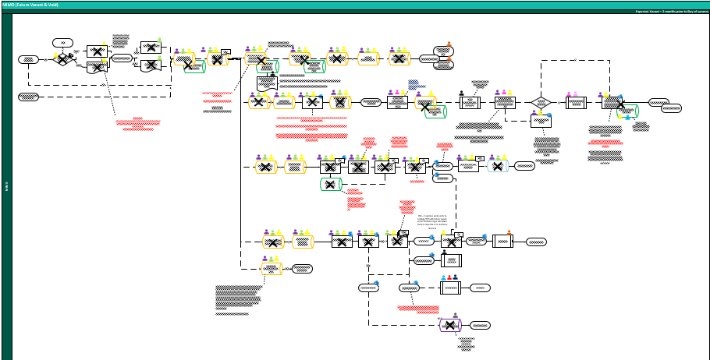
Manual steps taken during expected vacancy
There is an opportunity to rearrange, digitise, structure and integrate the notice to quit into expected vacancy MIMO, reducing ~25 manual steps by automatically triggering MIMO tasks, currently manually selected by employees
The notice to quit from tenants is received via various forms and funneled into an unstructured email
There is often missing data including the reason for leaving
Information is copy and pasted into evolution MRI
Manual responses to emails, including reactive retention calls
Opportunity:
Proactive rather than reactive retention, clarify roles and responsibilities with retention team
Digitise and structure the notice to quit, aligned with the fields required in evolution MRI
Integrate the data points to the systems required
Automate the data entry of multiple steps
All data required for move out email moved into system so email
does not need to be edited, automatically sent to tenant
System approval workflow on whether the future vacant email
is distributed and automated emails to team email addresses
Utilise customer facing technology to prompt tenants to self serve
their own appointments
Automated actions that do not require human intervention, such
as changing the direct debit in Salesforce to £0
Customer experience:
Customer facing application to track their required tasks to
vacating and are automatically notified of changes/ required actions
26

Slide 27
Delays on reletting properties
There is an opportunity to design structured logic-based rules on whether a property will be refurbished, based on its historic data, removing manual decision points, with an exception only workflow to PMs and relet dates standardised for marketing
Lettings Managers discussed delays and time spent chasing regarding marketing relets
Time taken to confirm whether a property will be refreshed, refurbished or sold
For a refresh, a standard 5-day TAT is estimated
For a refurbishment, Lettings are notified of practical completion by URM during handover to contractors, which triggers marketing
Third Party (Agents) are not completing system steps correctly:
Integration is not working between portal and SF
Manual steps are taken to transfer information via email
In person viewings take a lot of organisation:
85% in the North are let via video alone
In the south the majority are done in person
Opportunities:
Proactive tagging of properties with a strategy to sell
Proactive tagging of properties that require refurbishment
Potential for a rules-based logic for whether a property should go
into a refurbishment approval workflow:
length of time since previous works
properties not marked proactively to be sold
Provides an early indication on relet date
Retraining third parties and Lettings team funneling back to portal to ensure adoption
Pushing video lettings in the South, WhatsApp integration/ utilise customer app for off system comms with tenants
27

Slide 28
10+ handover points during move out
By simplifying technology/ integrating data points, the end-to-end process will become available to all functions and should reduce the handover points required via email and consequent delays , reducing TAT
Customer Services (PRS) & Property Managers (BTR) will update stages of the tenant moving out through Evolution MRI
Evolution MRI is used as the main tracker for legionella however there are no auto notifications, and it requires the assigned person to navigate into the task to track when this should be completed
Inventory is processed via Inventory hive with forms uploaded and the meter readings submitted to Evolution MRI manually, which is often forgotten
Asset Mgt & Lettings rely on Qube reporting to track voids/ voids cost and notify that the unit is ready to market
This information is also duplicated in Qube for key dates (Vacant date) and notes on the Void/ Refurbishment. This is then closed once completed
Due to the system not being user friendly on a field/mobile device, there are often delays to update MRI/Qube
Delays in updating systems and sending through communications via email leads to a lot of to and fro/ chasing and duplications of work
Rescinding notices and delays in refurbishment works are often difficult to track across numerous systems leading to off system communications, chasing and delayed updates to customers
28

Slide 29
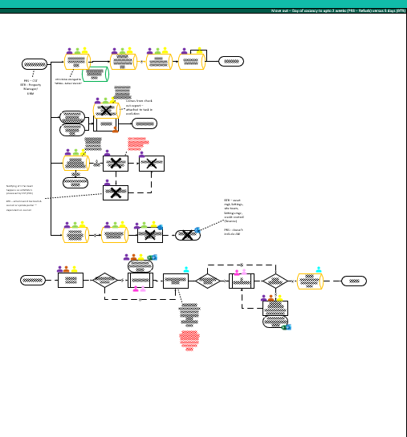
Manual steps taken during move out
There is an opportunity to reduce the manual keying of data during the move out (MIMO), reducing ~6 manual steps by automating the input/output of required data and communications to third parties
Property/Portfolio Managers and Customer Services, receive the check out inventory form via email or inventory hive, which they then extract and input the meter readings to MRI
Waiting/chasing the meter readings
Human error on input
Manual extraction and input from system/form to internal system
Manual Utilities/ Council Tax notifications
Opportunities:
Creating accessible systems to input information directly
Integration from inventory hive to MRI
Structured form inputs or RPA, which then feeds the data to all areas it
needs to be collected
Utilising customer facing technology for them to be able to self serve input of
meter readings
Emails are manually sent out to 9 different business areas to notify of vacancy
Template auto created and forwarded to business areas
Opportunity:
Auto notified directly without human intervention, can cc in PM, based on
Meter reading input
Standardised email inboxes for functions
Visibility for all functions to track within systems
29

Slide 30
3+ handover points during deposit return
By simplifying technology/ integrating data points, the end-to-end process will become available to all functions and should reduce the handover points required via email and consequent delays , reducing TAT
Deposit Return Instruction (DRI) form is delivered by Property Managers/ Service Desk, as early as possible, via the tenant move out email (notice to quit confirmation), this is off system and uploaded to Docushare once received.
There is currently nothing on the system to log that this has been received and relies on communication to parties involved, predominantly Finance
This leads to and fro as the bank details are required (to be returned on the DRI)
There are legal requirements on returning the deposit within several days of the tenant moving out (10-15% do not meet timeline)
It is currently unclear how the legal return timeline on deposits is tracked/proactively prevented
Currently if a DRI is not returned, the deposit will not be processed (<2%)
Following an inventory check, during the move out stage, the damages are detailed on an inventory return form which is then keyed into MRI with a Deposit Resolution Update. Once a Return of Deposit Form (or email in the North), is agreed with the tenant, Finance can begin to process the return.
Finance rely on being included in the Future Vacant email chain to give notice of an upcoming deposit return. They must then receive the DRI and ROD to return the deposit, both emailed via Property Managers/Service Desk. Finance often are not copied into emails and spend a lot of time chasing both forms and updates due to legal requirements on deposit return timelines
It is Finance responsibility to update/close account and stop charges on Qube, and to amend and cancel the direct debit on Salesforce. The DRI therefore must contain a Qube reference which is manually retrieved from the system once the form is created in MRI
30

Slide 31
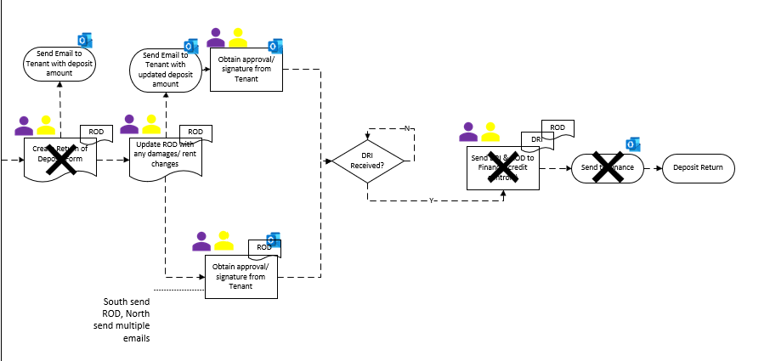
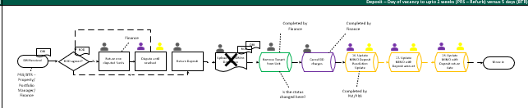
Manual steps taken during deposit return
There is an opportunity to reduce the manual creation of documents during the deposit return, reducing ~4 manual steps and 10-15 elapsed time per account, by automating the input/output of required data and communications to tenants
PMs must edit a Deposit Return Instruction (DRI) form for each move out, which requests the tenant bank details
DRI auto created in MRI, updated with tenant information and attached to the move out email
A lot of time is spent chasing this instruction
(10% of move outs)
10-15% are not returned within timeframe
Bank details are emailed between functions (GDPR)
A return of deposit form is created for each return
Agreement of return amount is sent within multiple email in
North, and within ROD in South
Finance manually perform stop actions across multiple
systems, taking 2-3 mins per account
Total time taken to return a deposit is 10-15 mins
Opportunity:
Use automation to process deposit returns and actions
In-system approval workflows
Integration/RPA when tenant is removed, other
steps in other systems are auto actioned
Customer experience:
More secure data transfer (GDPR)
Faster turnaround on deposit returns
31

Slide 32
4+ handover points during move in
By simplifying technology/ integrating data points, the end-to-end process will become available to all functions and should reduce the handover points required via email and consequent delays , reducing TAT
The move in task begins with the property updated to “ready to market” within MRI, usually completed by the Property/Portfolio Manager following a site check on completion of works
There are sometimes delays at this point if works have not been completed to standard, the lettings due date should be updated at this point in Qube for reporting to other teams
The move in appt is scheduled by the lettings team and input to MRI, assigned to a resource. With every update to the system every field in each system must be updated to align with changing timelines, leading to miscommunication and errors
Uncertainty on responsibility to close Void Notes/MRI meaning these are often left open until next tenant leaves
Multiple paper compliance forms are completed during move in session, scanned and uploaded to Docushare. The forms are signed and dated by tenants. This can be 10+ documents depending on the property type.
There is integration within adobe which is used for certain forms to be signed and returned/uploaded electronically. Interviewees were unsure why the paper documents did not follow the same process.
Move in checklists are used to track activities are completed, which must be signed and dated:
No ability to easily track each move in on MRI or across systems, only in Salesforce
32

Slide 33
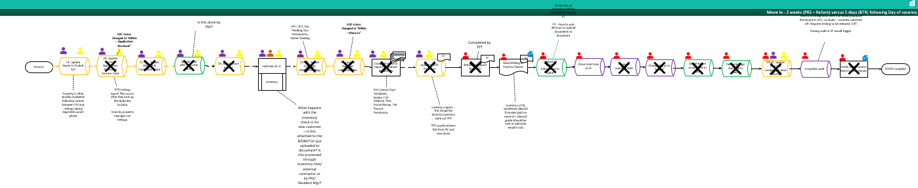
Manual steps taken during move in
There is an opportunity to reduce the manual creation of documents during the move in, reducing ~15 manual steps by automating the input/output of required data and communications to tenants
PMs must update actions in MRI/Qube manually that are already input by Lettings/TPT to Salesforce
Application received, move in date, Wishlist completion date, notes on void
Meter readings from inventory check in
Tenant information
During the move in appt, 10+ paper compliance forms are completed, scanned and uploaded to internal systems
Multiple steps are completed in SF, Qube and MRI to close a lease that could be populated with one trigger point
Includes email notifications/ information for customers e.g. (welcome email, settling in email)
Opportunity:
Digitise compliance forms, integration and/or RPA to input the same data to multiple systems
33

Slide 34
People process items differently
Asset Mgt
Procurement
Finance
Lettings
Property Mgr.
There is an opportunity to right size teams, clarify roles and responsibilities with clear RACIs,
handover points and trainings in place to ensure “one” process is adopted, and accountability taken
TPT
Portfolio Mgr.
Service Desk
Lettings offers are not being completed in a standardised way
Pre vacation inspections should be logged in an MRI task but are not always tracked
Move away from Qube so recent hires have not been told to update Qube or been given insufficient training
Sometimes must create the void note in Qube even though it should already be there
Final check performed day before move in which sometimes leads to a hectic day arranging final cleaning etc
Chasing contractors for quotes - 3 teams doing the same thing - 10-day TAT. Often too late and miss 10-day KPI
Information often not updated on Qube by Property Managers, currently a lot of property's are not marked as furnished
Huge difference in the way people log data upfront in MRI which really impacts TPT leading to a lot of chasing
Struggle to train their teams and advise on best practice as they do not feel confident in the process themselves
New MIMO process is harder - there is no ownership and is difficult to understand which tasks need to be done
Often direct debits are not set up prior to move in putting the tenant in immediate arrears
Notice to leave given through various inputs by different people and funnelled to written email
Don’t have any training on MRI & SF so don’t use them for any reporting/ information
Get a lot of queries on whether someone has moved out - sometimes they forget to update Qube
Legionella and Meter Readings are often not prioritised as well as other compliance aspects such as smoke detector testing, leading to vague and inconsistent audit trail
The North has a 3:1 unit to PM ratio & the South is 1:1
34

Slide 35
There are many system limitation perceptions
There is a longer-term opportunity to apply best fit technologies to “one” process, utilising/ expanding or integrating existing technologies and applying RPA to data transfer logic that can’t be integrated.
QUBE
Evolution MRI
Salesforce
No remote access, limiting near real time updates
Misalignment of unit data to Salesforce, leading to manual editing
Documents cannot be uploaded to Docushare until 48 hours after updating unit on Qube
Currently only integrated with MRI at static data level and does not integrate transactionally
Refurb information is held within notes and is not structured in a way to easily report on
Parking spaces logged as individual units – unclear whether unit has a parking space
No remote access, limiting near real time updates
All functions do not have access
All contact with contractors is usually completed off system due to restrictions on insurance requirements, led to a workaround in Proactis
Set up at unit/block level. Can’t issue multiple POs for one unit
No tracking capability/dashboards
No integration to Inventory Hive
All functions do not have access/trained
No integration to car parking portals
No integration to outlook calendar
Outgoing email communication only
Salesforce and WhatsApp not integrated
Salesforce app not currently utilised due
to data security limitations
Customers can skip past Direct Debit, placing them in arrears from month one
35

Slide 36
Current landscape may not be utilised to full potential
There is a longer-term opportunity to apply best fit technologies to “one” process, utilising/ expanding or integrating existing technologies and applying RPA to data transfer an logic that can’t be integrated.
1
Qube data feeds to the Azure Data Warehouse, feeding to PowerBI for reporting. However, reports are being pulled from Qube in excel for reporting
2
MRI and SF feed into the Azure integration and ESB service bus, feeding into Qube however it is unclear where this integration feeds between systems from interviews/ manual work completed
Inventory Hive & 3rd party portals are not integrated, information is double keyed between these systems
Spike app is a customer facing application which integrates to AWS, also integrating to SF, however it is not being utilised for straight through processing from customers to SF and unstructured manual inputs are used
2
1
2
4
3
2
4
3
36

Slide 37
Data Gaps can often be a result of other challenges
Once “one” process is designed, and technology overlaid, there is an opportunity to create space in systems for required information, to upload historic intelligence and centralise to one version of the truth
Data Gaps and all other challenges are codependent and often influence or result in each other:
Data input is all manual and prone to human error
Double keying into different systems can lead to information being forgotten or delays to non prioritised systems
Information shared outside of systems has resulted in localised storage of data
System limitations/48-hour delays to upload information to Docushare
Inability to track tasks end to end in one system leads to variances in data between business areas and isolated reporting/ ways of working – no one version of the truth
A lack of accountability, prioritisation and training mean data is not always uploaded, leading to unknown downstream impacts
Unstructured inputs to the system lead to unstructured fields, with note areas utilised which can be difficult to track, export and report on over time
Opportunity:
System changes to allow data to be stored centrally on system
Perform data quality exercise to truly establish gaps/ quality
Tactical automations to transfer documents and data from off system records
Align documents and data recorded nationwide to ensure processes and data quality is standardised
Simplify the data input process:
Applications that can be used out in the field
Integrate/ automate transfer of information between systems
All documents moved online to prevent delays in data upload
Performance manage the field updates of systems in near real time to keep tracking visible and communication active and central
37

Slide 38
SWOT Analysis
Overview of the strengths, weaknesses, opportunities and threats (risks) of the process discovery and next steps:
Strengths
Weaknesses
Salesforce overall is working well with positive comments around the visibility and tracking mechanism of the dashboards from Lettings and TPT
Automations within the MIMO task in Evolution MRI are helpful with emails auto created and documents provided
Integrations from Evolution MRI to Utilities services work well
Those who use the PowerBI report have commented that it is useful for financial reporting
Pilots to standardise/simplify are working – Relet process piloted at 1 PRS property has had successful results
Process - Complex processes with different ways of working, too many handover points
Data - Required information is often not available within systems, no visibility of the end-to-end process, no single version of the truth, no true picture of the voids cost or performance
People - Different resourcing between north and south, lack of accountability
Technology - System limitations, lack of integration/ automation, multiple systems
Opportunities
Threats (Risks)
Standardise and simplify to “one” process, regardless of property type, function or location
Pricing play book and price per property
Simplify transactional data collected and transferred to what is needed
Prevent double keying of system
Reduce documents created/handled by ~80%
Create rules-based logic wherever possible to reduce variation, automate triggers and actions reducing the need for manual steps taken by ~50%
Digitise input points between parties to ensure data collected is structured and aligns to the information required by the system
Overlay best fit technology to “one” process
Not collaborating/ workshopping the redesign of the process to bring people along the journey and account for all variation
Failing to follow strict design principles that account for “one” process, except for any legal requirement, customer issue or business need
Not establishing clear RACIs (roles and responsibilities) and change mgt of the redesigned process into adoption
Underestimating the need for KPIs and clear performance visibility to measure and continuously improve
Not doing due diligence of technology research and implementing technologies that may not be best fit
38

Slide 39
Appendices
39

Slide 40
Discovery Methodology
The methodology taken during discovery and during the interview process, including objectives of findings:
Methodology
Objectives
Deliverables – Review Findings
Conducted 2-hour interviews across 9 business areas
Understood each business area and the role played within the Voids Process
Walk through of the process, discussing individual challenges and pain points
Discussed the systems used, documentation produced and transferred
Collated challenges to high level themes and prioritised between business areas
Explored the root causes of challenges to recommend an opportunity summary for improvements
Process
Identify variation and understand where could be standardised
People
Identify areas of inefficiency around roles and responsibilities
Data
Identify data gaps/ quality issues and how they can be alleviated including GDPR, controls and compliance
Technology
Identify the touchpoints of different systems and where these could be aligned, integrated or utilised better/ expanded
Understand areas of the process that could be automated to increase efficiency and reduce voids time/costs
Presentation:
Process discovery PowerPoint
Background
Executive summary
High-level briefing
Detailed findings
Next steps
PEX Assessment & Guidance
Written document:
Process discovery document
Process maps
Process per function
Process per property type
Process per location
Process Metrics
Lean Assessment
Opportunity Grid
Opportunity Assessment
40

Slide 41
Process Mapping - Key
41

Slide 42
Process Metrics (1 of 3) :
Number of steps taken per function during the MIMO process, per property type and location (north versus South):
Business Area* | PRS Stabilised |  | PRS Reversionary |  | Bill to Rent
 | North | South | North | South | North | South
Portfolio Managers | 56 | 43 | 84 | 71 | x | x
Property Managers | x | x | x | x | 87 | 74
Customer Service Desk | 30 | 30 | x | x | x | x
Refurbishment | x | 20 | x | 20 | x | x
Lettings | 19 | 20 | 19 | 20 | 23 | 23
Tenancy Progression | 23 | 23 | 23 | 23 | 23 | 23
Finance – Credit Control | 7 | 9 | 7 | 9 | 7 | 7
Asset Mgt | 17 | 13 | 17 | 13 | 14 | 14
Procurement | 1 | 1 | 1 | 1 | x | x
Total | 153 | 159 | 151 | 157 | 154 | 141
Total (internal)** |  | 139 |  | 137
External contract work is not included – Marketing, Inventory, Lettings Referencing
** Does not include Unit Refurbishment Management tasks provided by TFT
42

Slide 43
Process Metrics (2 of 3):
Number of documents created/ handled per function during the MIMO process, per property type and location (north versus South):
Business Area* | PRS Stabilised |  | PRS Reversionary |  | Bill to Rent
 | North | South | North | South | North | South
Portfolio Managers | 20 | 18 | 20 | 18 | x | x
Property Managers | x | x | x | x | 20 | 19
Customer Service Desk | 5 | 5 | x | x | x | x
Refurbishment | x | 9 | x | 9 | x | x
Lettings | 2 | 2 | 2 | 2 | 1 | 1
Tenancy Progression | 14 | 14 | 14 | 14 | 14 | 14
Finance – Credit Control | 2 | 2 | 2 | 2 | 2 | 2
Asset Mgt | 4 | 4 | 4 | 4 | 4 | 4
Procurement | x | x | x | x | x | x
Total | 47 | 54 | 42 | 49 | 40 | 39
Total (internal)** |  | 45 |  | 40
External contract work is not included – Marketing, Inventory, Lettings Referencing
** Does not include Unit Refurbishment Management tasks provided by TFT
43

Slide 44
Process Metrics (3 of 3):
Number of emails per function during the MIMO process, per property type and location (north versus South):
Business Area* | PRS Stabilised |  | PRS Reversionary |  | Bill to Rent
 | North | South | North | South | North | South
Portfolio Managers | 13 | 12 | 19 | 18 | x | x
Property Managers | x | x | x | x | 19 | 19
Customer Service Desk | 10 | 9 | x | x | x | x
Refurbishment | x | 5 | x | 5 | x | x
Lettings | 4 | 3 | 4 | 3 | 3 | 2
Tenancy Progression | 3 | 3 | 3 | 3 | 3 | 3
Finance – Credit Control | 3 | 3 | 3 | 3 | 3 | 3
Asset Mgt | 5 | 4 | 5 | 4 | 4 | 4
Procurement | 1 |  | 1 |  | x | x
Total | 39 | 40 | 35 | 37 | 32 | 31
External contract work is not included – Marketing, Inventory, Lettings Referencing
** Does not include Unit Refurbishment Management tasks provided by TFT
44

Slide 45
Challenges by function
Interviews across business areas led to the output of 200+ challenge/ pain points. Most challenges are common between areas and can be rolled up to the below main themes:
45

Slide 46
Interview Detail – Verbatim & Metrics
Summary of response:
Verbatim provided by all functions during interviews, regarding process steps/flow, challenges, limitations, pain points
Metrics requested from functions* however the response rate was low and of those who provided figures, there were a lot of unknown and data gaps.
Business Area* | Verbatim |  | Metrics
 | North | South | North | South
Portfolio Managers |  |  | x | x
Property Managers
Customer Service Desk |  |  | x
Refurbishment | ** |  | **
Lettings |  |  | x
Tenancy Progression |  |  | x
Finance – Credit Control |  |  | x
Asset Mgt |  |  |  | x
Procurement |  |  | *
*Metrics were not requested from Procurement due to minimal involvement
**Completed by Property/Portfolio Managers
46

Slide 47

Verbatim – Portfolio Managers (PRS)
“Difficult to figure out whether unit has a parking space”
“Roles and Responsibilities between Customer Services & us are unclear”
“PowerBI is not being used/ monitored by team - no remote access to dashboards so everything is tracked off system”
“Established handover points with Property Managers are not used”
“PVI/PMI/water flushing are not prioritised”
“New MIMO process is harder - there is no ownership and is difficult to understand which tasks need to be done”
“Double keying of information to both MRI and Qube”
“Key Location/Release - more complex than it should be ”
“Data on units has been stored within notes and off system leading to gaps in knowledge and within systems re units, lack of visibility across business”
“Not many are using the MIMO task, many are using emails.”
“No dedicated partner in Customer services so things often lost in translation, do not have strong knowledge of portfolios/units”
“Pre vacation inspections should be logged in an MRI task but are not always tracked”
“Meter Readings are often not input to MRI following the check out/ inventory report returned via Inventory Hive”
“Ratio of PMs to units is 3:1 north compared to 1:1 in South”
“Portfolios have a separate office to site (different to BTR), meaning there are delays from work onsite being uploaded to systems ”
“Retention calls made by Portfolio Managers after notice is provided, not proactive”
“Unstructured input for Notice to Quit, various inputs and funneled to written email”
embracent | IT Review – emerging thoughts #2
47

Slide 48
Verbatim – Property Managers (BTR)
“Multiple paper compliance forms completed during move in session, scanned and uploaded to docushare”
“Manually inputting Meter Readings to MRI, when processed via Inventory Hive”
“Have to have "off system checklist" as tasks completed in different systems - microsoft list in south/ excel in north”
“Unstructured input for Notice to Quit - always have to request reason for leaving from customer”
“Double keying of information to both MRI and Qube”
“Constantly checking SalesForce for information on move in date, with off system comms on details with Lettings/TPT in Teams as not in the system”
“Managers all process tasks differently”
“Sending out update emails to different business areas (up to 9)”
“Contacting utilities suppliers/Councils to cancel contracts (not automated in MRI for BTR) and supplying meter readings”
“DRI/ROD is manual process, off system with updates re tenant details and editing and resending if changes”
“Delays to relet days are communicated off system and often not updated in system, leading to customer complaints on move in day”
“All appointments arranged bt TPT - communication sometimes bad between teams and have often had a tenant on site and have to arrange documentation signing/ taking deposits as has not been done before hand”
“If refurbishment work is needed, must raise "yes" in MIMO to notify however all contact with contractors completed off system, with different contractors/ways of working in each location”
“Parking must be logged in 3 systems - portal registration, net2. Access for carpark, register with locker system (if they have)”
embracent | IT Review – emerging thoughts #2
48

Slide 49
Metrics – Property Managers (BTR)
Metrics provided for North only:
Description | Metric*
Volume of Expected Vacancies (monthly) | ~89
Task Time to create documents | Not known
Lead time Expected Vacancy notification to Move out | ~60 days (about 2 months)
Volume of Move outs (monthly) | ~89
TAT on refresh | Not known
How many refreshes do not start on day 0? | Not known
How many refreshes overrun/ have issues? | Not known
Lead time Return deposits (move out date to deposit return date) | ~7 days
* Metrics collected from stakeholders following interviews
49

Slide 50
Verbatim – Customer Service Desk (PRS - stabilised only)
“Get a lot of queries on whether someone has moved out - sometimes they forget to update Qube”
“Logging of data from NTQ emails/ other emails into MRI”
“Manual notification to utilities and manual notification of vacancy to lettings team via email ”
“Notice to quit received via many suppliers - tenants directly/ PMs and Renewals team”
“Finding gas certificates is a major pain point - must look through MRI/shared drive”
“If any delays all steps within system must be repeated and updated”
“Emails are manually uploaded to MRI, must be edited first as does not accept email“
“DRI does not contain a Qube reference, this has to be manually retrieved and manually edited”
“Manual input of meter readings to MRI”
“Notice to quit received via email/ not structured input, in body of email - doesn’t appear to be received via app”
“Information is input to MRI, this triggers the creation of two emails, these are emailed to the customer services agent for editing”
embracent | IT Review – emerging thoughts #2
50

Slide 51
Verbatim – Finance
“Lack of consistency, different communication used/forms”
“Chasing for completion”
“Often receive request for a return of deposit and haven't been previously notified of a future vacancy”
“Multiple updates of different systems; Cancel direct debit in SF, close account & stop charges on Qube”
“Often direct debits are not set up prior to move in putting the tenant in immediate arrears”
embracent | IT Review – emerging thoughts #2
51

Slide 52
Metrics – Finance
Description | Metric* | Metric*
Average Volume of Move outs/ deposits returned | ~242 | ~242
Task Time to perform stop actions on systems for payments | ~ 2-3 minutes | ~ 2-3 minutes
Task Time to return deposit | ~ 10-15 mins per deposit | ~ 10-15 mins per deposit
% of move outs where you must chase for the DRI ~10%
% of deposits that are not returned within required timeframe | ~10-15%
* Metrics collected from stakeholders following interviews
52

Slide 53
Verbatim – Asset Mgt
“Don’t have any training on MRI & SF so don’t use them for any reporting/ information”
“Refresh/Relet – North does not get support from wider team, South has SPM & Pm who approve pricing/ quotes ”
“Move away from Qube so recent hires have not been told to update Qube or been given insufficient training ”
“North is copied into future vacant/ vacant email to track MIMO whereas the South has weekly void meetings with other business areas”
“Information about the status of a unit/ tenant should be able to self served - no one source of truth”
“Lettings offers are not being completed in a standardised way”
Not notified of works completed and need to know to update tracker. Constantly checking Qube/ weekly Voids meeting“
“Don't have all knowledge saved in one place - very reactionary and not much forward planning done”
“Only use Qube/ Power BI to run expenditure reports (void and future vacants every week”
“Not enough visibility of the condition of units - yearly visits not being recorded and shared to better plan”
“North receives a CUA Form and quotes, whereas the South receives a Job Auth Form with separate trackers”
“Can't obtain history of buildings from systems, excel sheets collated by various teams over time. Refurb notes in Qube are unstructured”
embracent | IT Review – emerging thoughts #2
53

Slide 54
Metrics – Asset Mgt
Metrics provided for North only:
Description | Metric*
Average volume of approvals | ~ Approves 5 a week as an absolute max. Some weeks may get none
Average % of refurb/refresh | Mostly refresh as quantum of units requiring refurb has vastly diminished
Task Time to process an approval | 10 mins
Task time to create Voids Reports | Done on Power Bi – takes2-3 minutes
Task time to create/maintain Capex schedule (south) AMI Tracker (North) | To add each new additional approval to the AMI 5 mins
Average cost of a refurb | In last FY c£18k
Average cost of a refresh | In last FY c£3k
Average void cost for a refresh | Not known - This is being looked at by wider business at present to try and quantify
Average void cost for a refurb | Not known - This is being looked at by wider business at present to try and quantify
Average % that need to be reapproved due to changes | ~5%
Average % that overrun agreed start/completion dates | Not known - don’t track start and end date.
* Metrics collected from stakeholders following interviews
54

Slide 55
Verbatim – Refurbishment
“Complete handover form (word doc) with contractors”
“URM only uses Qube/Proactis so information has to be input to other systems manually ”
“Use TFT as third party who deliver refurb process on Grainger's behalf, in the North property managers conduct themselves”
“Tenancy availability for visits”
“Manual updates of refurbishment diary in Qube ”
URM will often update Qube/ via email and Property Managers/ Lettings will update SF“
“URM use secure file share which gives read receipts to say info has been downloaded, provide quote back via email ”
“A lot of information is manually input to Qube, copying information from refurb reports to the refurb diary”
“No ability to track payments as PO's are not linked”
“Contractors are instructed to raise PO through Proactis "no PO no pay". Small works order prepared by URM and emailed to contractor”
embracent | IT Review – emerging thoughts #2
55

Slide 56
Metrics – Refurbishment
Metrics provided for South only, North uses Property/Portfolio Managers:
Description | Metric* | Metric*
Average Volume of Refurbs (Annual) |  | 50-80
Task Time to create package (JA Form etc) |  | 1-2 days
TAT on Quotes from contractors |  | 5-7 days
Average TAT on refurb works (start to completion) |  | 8-10 weeks
Average % that do not gain approval from asset mgt/ need to be reworked |  | 20%
Average % of units that do not have floorplans |  | 30%
Average % of tenders with 2-3 contractors (more than 1) |  | 90%
Average % of refurbs that start on Day 0 (move out day) | 40%
Average % of refurbs that require multiple POs | 100%
* Metrics collected from stakeholders following interviews
* Metrics collected from stakeholders following interviews
56

Slide 57
Verbatim – Lettings
“In the south we have weekly void meetings to determine relet dates whereas in the North it is typically 5 days TAT”
“Sometimes must create the void note in Qube even though it should already be there”
“Noting - must copy and paste emails/WhatsApp conversations to SF”
“Not all information provided on customer services email - need to often go back to property managers”
“Live works often can't hold to date - move in delay comms come from P Mgr. to Lettings who communicate with customer. Comms sent via outlook, logged in SF”
“Use MRI for all other processes, only use SF/outlook within the voids process and MRI for invoicing. ”
Teams have different access to systems and most comms are sent out of system due to this. Lettings/ TPT on SF and Customer Services on Qube“
“Information often not updated on Qube by Property Managers, currently a lot of property's are not marked as furnished”
“In the north the Service desk is more involved, handling inbound lead calls and logging information in Salesforce”
“Differences between north and south on who completes tasks; North is TPT and South should be TPT but Negotiators are updating SF”
“There is a lot of double keying from Salesforce to MRI”
“Manual update in SF - unit status to "future vacant" and available date - should be auto updated but doesn’t seem to work and the data is always the old date ”
“Variation between north and south, including documents used and relet times and the way we market units”
“Manual change of letting due date on the void note, and updates SF status to "on the market" ”
embracent | IT Review – emerging thoughts #2
57

Slide 58
Verbatim – TPT
“We must update everything in Qube once completed in Salesforce”
“If a let is closed down/lost - refund button auto changes in SF to "hold in basket", should change to "on the market"”
“Tenants are given a month to rescind, vacancy sometimes closed by other business areas and don't notify TPT, leading to failure of their KPIs ”
“External agents do not say where keys are kept leading to issues on move in days”
“Audit checklist is currently not being used due to being "too longwinded"”
Huge difference in the way people log data upfront in MRI which really impacts TPT leading to a lot of chasing“
“Welcome emails - automation not currently used as systems not up to date with all documentation”
“Often double keying information between Salesforce, Qube to align with MRI (especially year end) "stuck in the middle”
“Parking licenses are completed differently north to south. North does not interact with Qube, South uses Qube and a template for SF”
“Outlook/SF not integrated meaning manual rework between the two, to correspond meetings & appointments”
embracent | IT Review – emerging thoughts #2
58

Slide 59
Verbatim – Procurement
“Sometimes quotes cannot be found in the system”
“Manual check on quotes via email ”
“People tend to work off systems leading to data not being in the system - circular ”
“NO SLAs with contractors”
“Contractors often contacted out of system due to restrictions on MRI if insurance etc has expired. Leads to using proactis to raise Pos. ”
“contractors go to PM rather than via MRI - should they go via Customer Services? ”
Standardise Specification for BTR & PRS with tick boxes/ standardised pricing“
“Chasing contractors for quotes - 3 teams doing the same thing - 10-day TAT. Often too late and miss 10-day KPI”
“Biggest challenge is variance between contracting north/south, PRS/BTR leading to hugely different ways of working/processing/documentation/third parties”
“PM giving tech spec and aren’t trained leading to cost increasing later as haven't allowed for something. ”
“No standard specifications/quantities/measures for tenders leading to bespoke and varying quoting”
“Contractors go straight to PM rather than using MRI”
embracent | IT Review – emerging thoughts #2
59

Slide 60


Process Excellence Assessment (1 of 3)
Overview of process excellence maturity framework:
Base | Evolving | Performing | Optimised | Next Gen
Decentralised and non standardised documentation of processes. Knowledge of regulations and SLAs. | Framework for documentation active and aligning on future Vision and Strategy | Standardised documentation of processes, centralised visibility with all people and customers clear on consistent actions | Documentation model in line with QMS ISO 9001. Action documents embedded to track regulation processes and SLAs | Continuous visibility through digital process mining. Processes tracked, reviewed and amended to reflect evolution
Traditional channels operating well, reactive to individual requests | Having a systematic approach to solving user and customer problems, engaging frequently, SLAs for processes in place | A clear and easy to digest customer service delivery model in place that is aligned to the business strategy | Proactive and strategic support to customers and their decision making, seat at the table | Customer and user led services, minimal/zero contact, real time delivery, predictive, customer experience is key driver of services
Non-standardised, fragmented, disparate processes. Manual effort. Around lower quartile in performance. | Global Process Owners for core processes. Driving standardisation and consolidation. Plans to automate/stop non-value adding tasks through the roadmap | Standardised processes throughout, Process governance driving continuous improvements. Automation successful at eliminating manual effort | Processes fully automated, exception reporting. Cycle times optimised. Benchmarks around top quartile | AI and Machine Learning, digitised Business Process Intelligence on core processes and metrics
Processes performed with little training, governance or bottom-up challenges “because we have always done it this way” mentality | Process Excellence vision communicated to Global Process Owners, aligned on future vision and strategy | Culture and training introduced, starting to bring people along the improvement journey through the Centre of Excellence | Change champions embedded within teams, challenging processes and making minor improvements | Introduce global technologies to empower colleagues to continuously nominate, prioritise and action changes for themselves and customers
Lack of Process Excellence Vision or Strategy, a recognised need to realign core processes with the organisation’s direction | Process Excellence team formed, active and aligning on future Vision and Strategy | Centre of Excellence created, and a Continuous Improvement Programme enabled | Roadmap of change delivering tangible benefits in line with strategy, positive customer feedback | Continuous refinement of existing processes, utilising the PEX framework, toolkit and technologies
Process
Understanding
Customer Experience
Process Efficiency
People &
Culture
Continuous Improvement
60

Slide 61
Process Excellence Assessment (2 of 3)
Assessment of Grainger plc against the maturity framework:
Base | Evolving | Performing | Optimised | Next Gen
Process
Understanding
Customer Experience
Process Efficiency
People &
Culture
Continuous Improvement
61

Slide 62
Process Excellence Assessment (3 of 3)
Assessment of Grainger plc against the maturity framework:
Base | Evolving | Performing | Optimised | Next Gen
 | Business Optimisation team exists however process documentation is being completed by individuals, decentralized and with huge variation. No mapping templates or governance structure
 | Customer service desk in play to attend to customer experience/ issues however RSA/PM’s main point of contact. No mention of VOC or feedback loops within process
 | Business Optimisation team focus is on systems/ functions rather than by process, efforts towards RPA programme in past however automations are still not in BAU – adoption and data
 |  | Business Optimisation team in play but no formal CoE. Evidence of training/ SOPs and lunch and learns and a continuous improvement mentality, although not widespread
 | Business Improvement team led by PMO, aligning to wider projects and business strategy. No business/ process analysts, improvement team are role shares
Process
Understanding
Customer Experience
Process Efficiency
People &
Culture
Continuous Improvement
62

Slide 63
Process Understanding (1 of 3)
Clear and reliable visibility of the way data flows through your organisation. Insight of Process Metrics and Pain Points to aid decision making.
Implement a QMS:
We recommend a Quality Management (IS0 9001) approach to process excellence governance, documented using a standardised and repeatable methodology.
ISO 9001 contains the requirements an organisation must comply with to become ISO 9001 certified, and is based on Seven Quality Principles that align with the {embracent} approach:
{e} approach
Customer
Experience
People &
Culture
Process
Understanding
Continuous Improvement
Process Efficiency
ISO 9001 Quality Principle
Customer Focus
Leadership
Engagement of People
Relationship Management
Process
Approach
Improvement
Evidence Based Decision Making
Know and meet your customer’s current requirements, predict future customer needs and always strive to exceed their expectations
It is the responsibility of Top-Level Management to create an environment where everyone can work to achieve the organisation’s objectives
Training employees to ensure they have the tools and techniques they need to do their job and contribute to the organisation’s success
Select suppliers and stakeholders that can create value by managing costs and optimising resources
Business activities should be managed as a process to achieve your desired result in the most efficient way
Your organisation should always strive to continually improve their overall performance – this should be a permanent objective
When data reveals that an area is underperforming, it is important to take corrective actions to improve performance
63

Slide 64
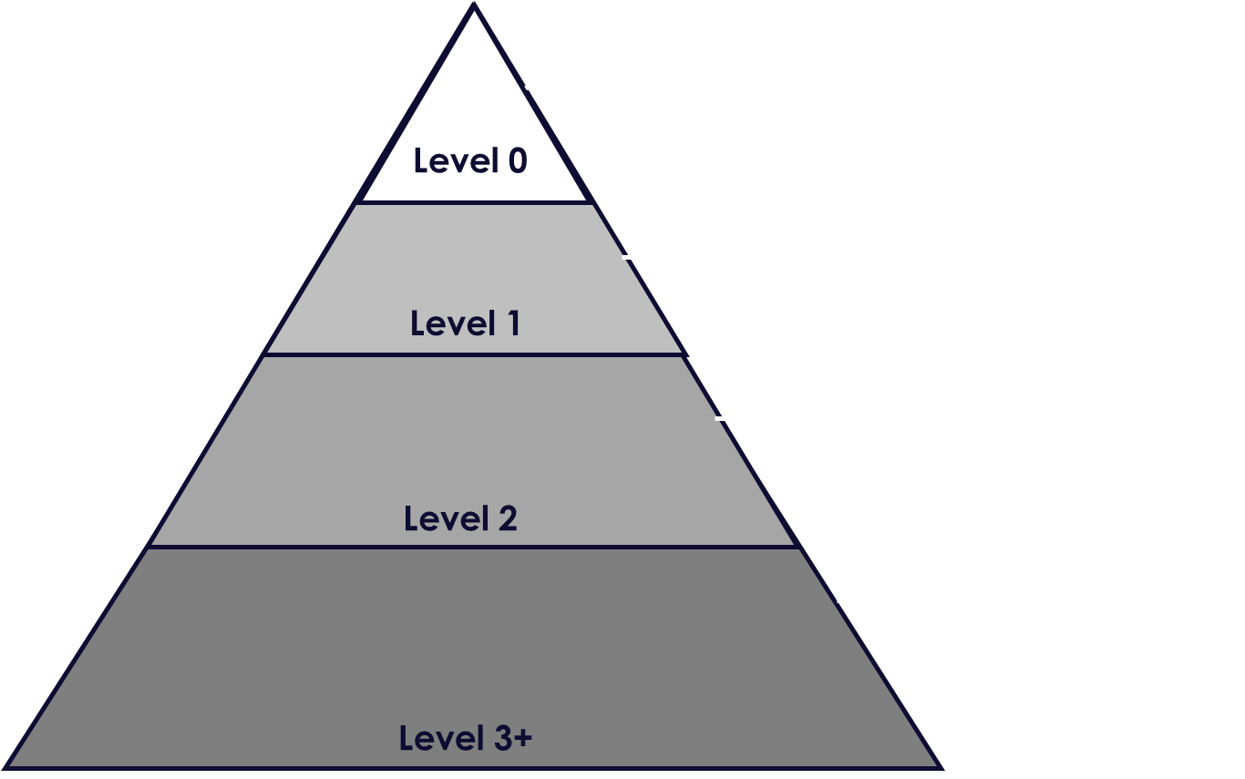
Process Understanding (2 of 3)
Clear and reliable visibility of the way data flows through your organisation. Insight of Process Metrics and Pain Points to aid decision making.
Document your operations:
Business Strategy & Objectives
Business Drivers & Vision, Operating Model
Process Landscape
Captures core business processes
Provides high level structuring aiding in allocating ownership
Process Library
Captures process scenarios
Understands SLAs/KPIS/VOC
E2E Process Flows to Charters
Level 3 to 5
3: A simple sequence of processes involved to execute scenarios, how IT systems cover the process
Understandable process flows that capture decision points, inputs & outputs
64
64

Slide 65
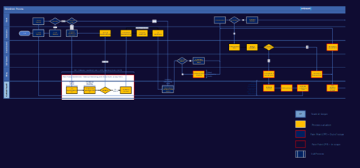
Process Understanding (3 of 3)
Clear and reliable visibility of the way data flows through your organisation. Insight of Process Metrics and Pain Points to aid decision making.
Understand and improve your operations:
Understanding the current situation (“As-Is”, Level 2)
During an initial understanding of core processes. We challenge on the below two points:
How do processes and systems currently work?
How well do they perform?
Understand your high-level core process scenarios
Appreciate the business areas Involved, upstream & downstream dependencies
Establish breadth of process variation
Recognise process pain points including integration and data quality Issues/ error rates
Identify cycle times, volumes, frequency, Required FTE & peak processing times
Understand your KPI/SLA touch points and assess performance against vision
65
65

Slide 66
Customer Experience (1 of 2)
Processes built around the customer voice and their needs and expectations
Map your Customer Journey:
Customer Journey Mapping is the process of creating a visual story of your customer’s interactions with your organisation. This can help your business to see things from the customer’s perspective.
3rd Party Sites
Digital Touchpoints
Digital Billboard
Landing Page
Mobile
Website
Emails
Awareness
Consideration
Purchase
Service
Loyalty
Word of Mouth
Call Centre
Radio
TV
Print
Promotion on Invoice
Physical Touchpoints
Managed Touchpoint
Unmanaged Touchpoint
66

Slide 67





Customer Experience (2 of 2)
Processes built around the customer voice and their needs and expectations
Collect VoC (Voice of the Customer):
It is important to understand the Voice of the Customer (VOC) to establish the critical-to-customer requirements (CTCs) and then define the critical-to-quality characteristics (CTQs) of your processes. embracent recommend using Lean Six Sigma tools and techniques to gather the VOC.
VOC Roadmap:
Identify internal and external customers
List and prioritise the customer
Plan VOC data collection
Collect VOC data
Translate CTCs into CTQs
Prioritise CTQs
Confirm CTQs with the customer
Techniques to gather VOC data include:
Customer interviews
Online or in-person customer surveys
Monitoring website behaviour
Recorded call data
Live chat
67

Slide 68
Process Efficiency
Utilising tools and techniques to simplify processes, stripping waste. Implementing best fit technologies to deliver and track efficiencies
Use a Lean Six Sigma (LSS), Continuous Improvement approach:
Define
{Evaluation to
Improvement Plan}
Measure
{Evaluation to
Improvement Plan}
Analyse
{Evaluation to Improvement Plan}
Improve
{Improvement Plan to Execution}
Control
{Realisation to
Evolution}
What is the vision?
Clarify the problems to solve
Decide how you will measure the current situations
Agree on what will be considered as success
Where are we now?
Understand the current situation (“As-Is”):
How do processes and systems currently work?
How well do they perform?
Where do we want to be?
Understand the root causes behind current performance levels
Identify where to act to achieve the best results
How do we get there?
Did we get there?
Identify potential solutions
Prioritise, build and sign off on recommendations
How do we keep the momentum going?
Process learning & Performance Capture
Ensure improvements are maintainable
Build mechanism for continuous improvement
Objectives
The objectives drive the measures to be conducted
The measures highlight priorities to analyse
The analysis provides root causes to address in “improve”
Improvement recommendations are turned into an implementation plan
Ongoing measurements allow assessment and continuous improvement
Activities
Detail Objectives, Vision and Scope through Basic – Next Gen assessment
Define Bullseye – core process landscape and measures of success
Automation Proof of Concept
SIPOC & HL Process Maps
“As-Is” process performance metrics
Standardised Approach (QMS)
Set up Centre of Excellence
Detailed Lean Six Sigma Review & Process Redesign
Business Case for Change
CoE review
Implementation Plan
Set up IT infrastructure
Implement To-Be Process
Testing & Quality Review
Training and Business Change
Embed Process to BAU - validate that objectives have been met
Reporting – Conduct measures similar to the ‘Measure’ phase
Benefits Realisation – Back to Analyse or Evolve, Identify new opportunities for improvement
68
68

Slide 69
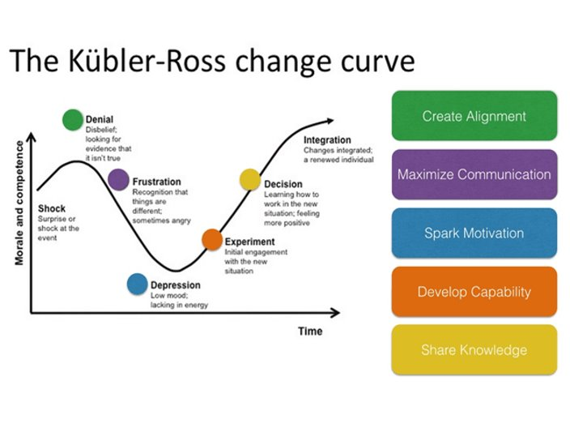
People & Culture (1 of 2) Engaged and enthusiastic improvement initiatives through an established process excellence culture
Make change stick:
Making change stick is critical, whether technology enabled or other. The change curve is well documented and understood, but in our experience often not applied
Change management has four key phases:
Shaping the change
Readiness for change
Delivering successful change
Embedding change
Building effective change leadership into the roadmap is vital to ensure that the business is prepared and ready for the “downs and ups” that lie ahead
Sell the Future Vision
…driving ownership of the change and ‘Winning Hearts and Minds’
Manage business benefits and change adoption
…to increase odds on achieving the expected outcomes of the change
Lead people
…through complex, business critical, time critical change
Drive cultural and behavioural change
…to increase adoption of changes
Develop others
…in understanding and applying change leadership techniques to drive business success
69

Slide 70
People & Culture (2 of 2) Engaged and enthusiastic improvement initiatives through an established process excellence culture
Create and embed a process CoE (centre of excellence):
What is a CoE?
A process CoE brings together stakeholders from across the organization to create a single, well-defined group that is responsible for making decisions when it comes to companywide processes..
Hybrid representation of SMEs, IT, Decision Makers and Change Managers
Enables improvement scalability through the establishment of business wide:
QMS standards, processes and procedures
Sharing best practices
Driving common technology adoption
Creating a robust governance model
Tracking existing KPIs/SLAs and improvement
automations and
Removing barriers to success
Identifying and prioritising business wide
Candidates for improvement
CoE
Functions
Business Units
Shared Services
Technical Support
70

Slide 71
Continuous Improvement (1 of 2) Continual evolution of processes through incremental and breakthrough improvements
Reassess your vision and strategy for process excellence annually
Maintain a centre of excellence to maintain standards/governance and manage and drive in change
Continually understand the needs of your customer through feedback and touch points in processes, measured in KPIs
Empower and educate people to challenge the status quo, tailoring processes to meet customer needs as well as their own leaving change to come bottom-up as well as top-down
Monitor core process and regulatory metrics to track, assess and amend your processes/ train your people
Scale your improvement journey through intelligent automation, leading to a more strategic and thoughtful workforce
Stay ahead of efficiency and process intelligence technologies, evolving and working smarter rather than harder
Combine all process excellence elements to keep the momentum going:
Centre of excellence
Continuously improving processes
Strong, representative team with solid knowledge
Reusable components
‘Work smart not hard’
Design standards & best practice
Stable monitored environments
Lightweight but consistent governance
71

Slide 72
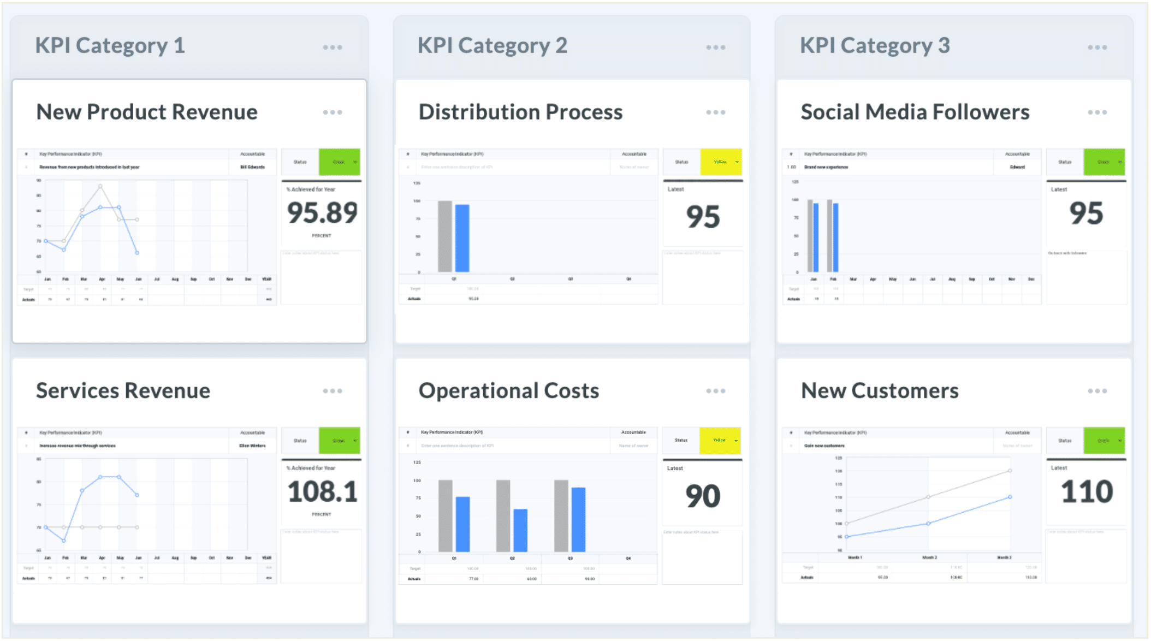
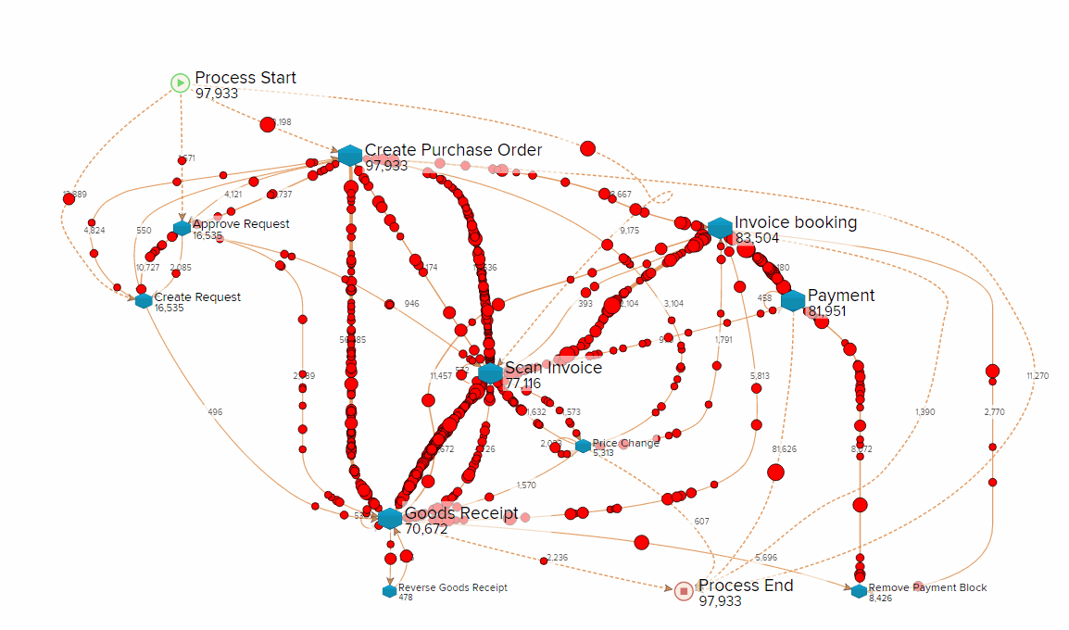
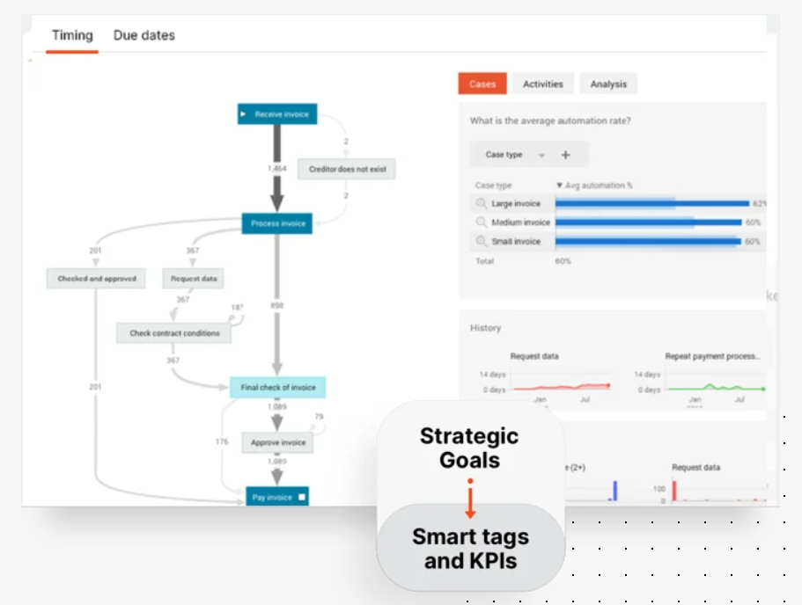
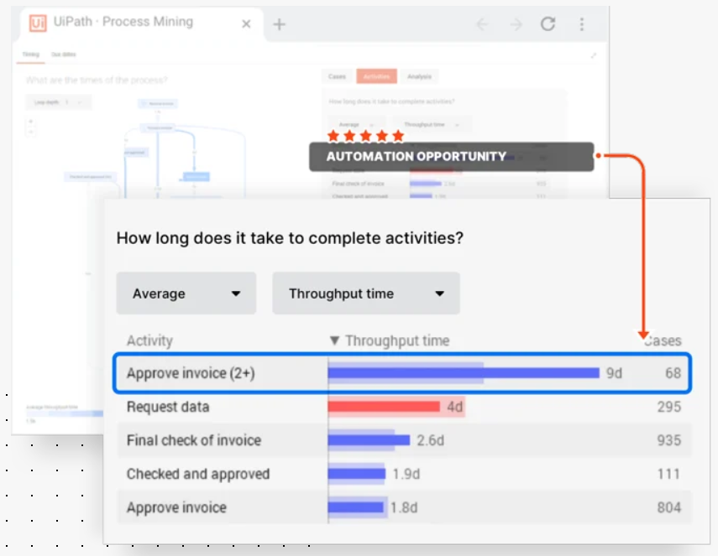
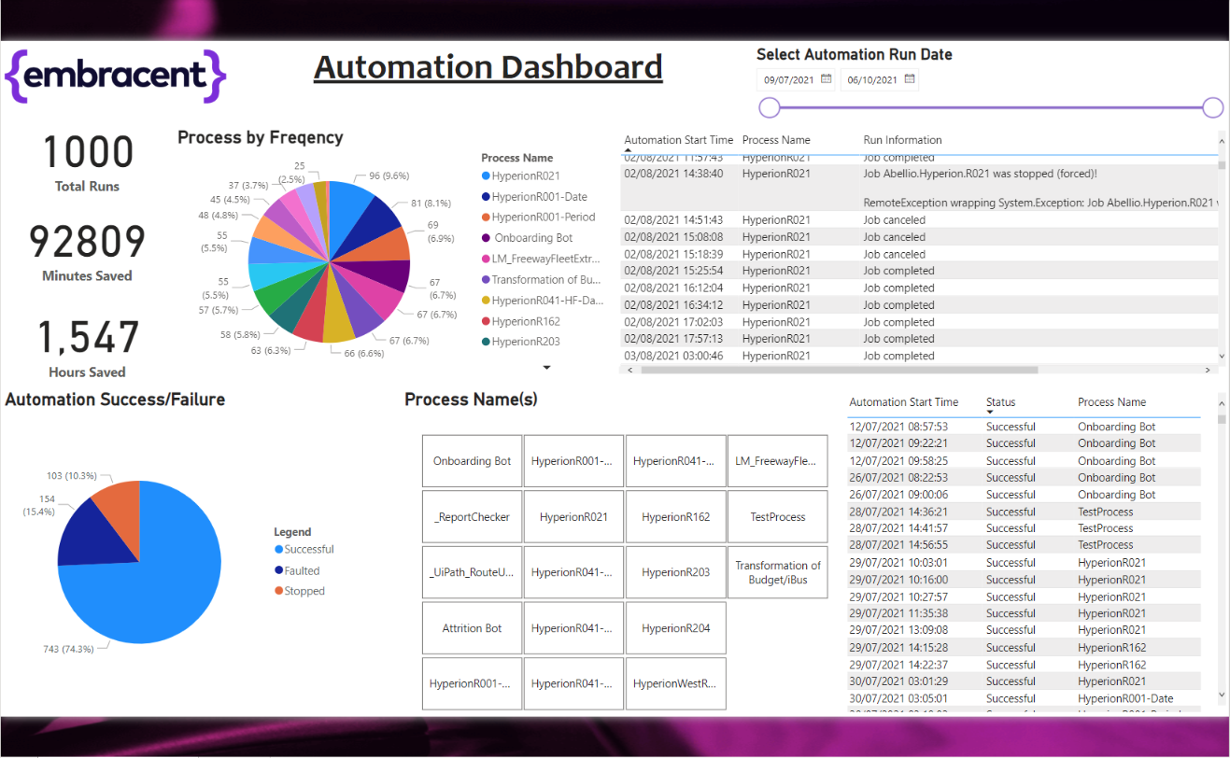
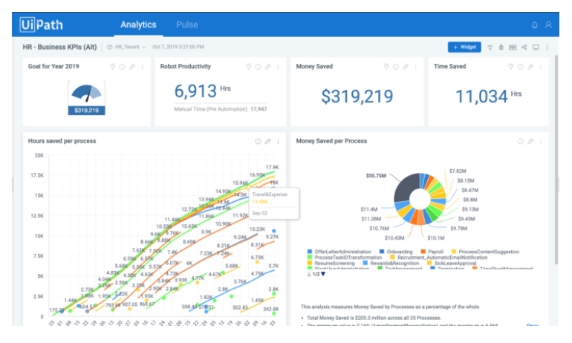
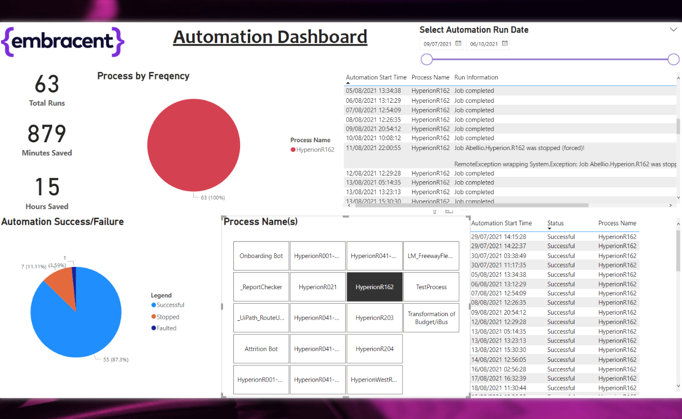
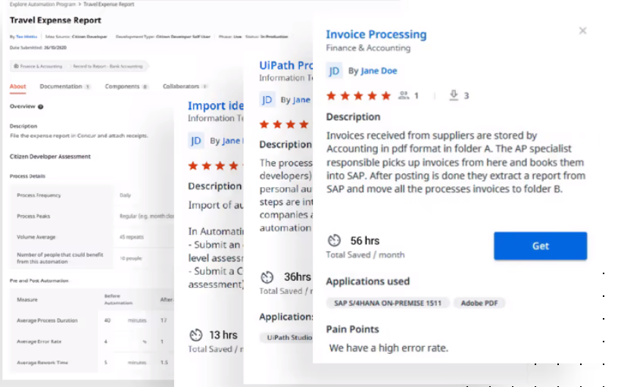
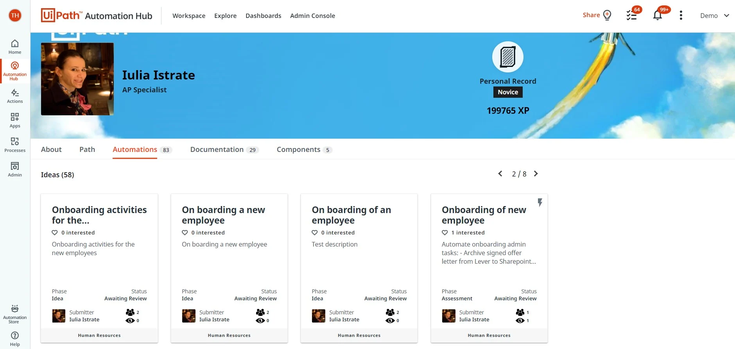
Continuous Improvement (2 of 2) Continual evolution of processes through incremental and breakthrough improvements
Implement technologies to elevate your improvement programme, in line with your vision:
Digital process/task mining
Tracking processes digitally, directly from your systems
Uses System event logs and timestamps to map in near real time
Exposes variations from the norm and tracks cycle/lead times and errors down to employee level
Automation analytics dashboards
Tracks running of automations business wide
Allows easy analytics of benefits and barriers to success/ data quality issues
Process intelligence dashboards
Tracks performance of core processes/ Business Objectives
Measures Key metrics (KPIs/SLAs/VOC against set targets over time)
Informs tactical and strategic reporting/decision making
Process identification & prioritisation software
Your people across the business have access to nominate and assess processes for improvement/automation
Encourages bottom-up approach and standardises documentation and governance
72

